Slide 1



ZENLISH – HỌC TOEIC 1 LẦN LÀ ĐẠT
BEGINNER’S TOEIC
LESSON 3

Slide 2



ZENLISH – HỌC TOEIC 1 LẦN LÀ ĐẠT
BEGINNER’S TOEIC
LESSON 3
CÂU HỎI WHAT/WHICH + WHY + HOW

Slide 3



NỘI DUNG BÀI HỌC
1
Ví dụ
Thực hành
3
2
Lý thuyết
Từ vựng
4

Slide 4


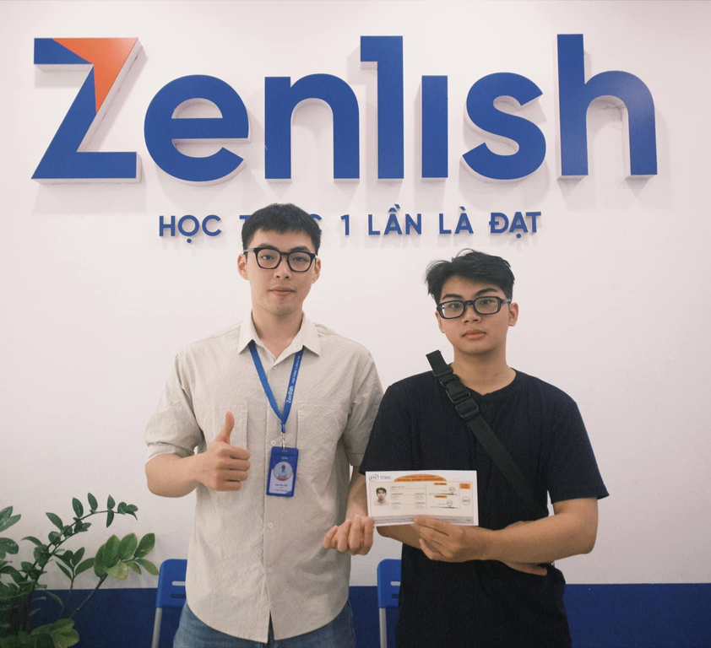


ZENLISH – HỌC TOEIC 1 LẦN LÀ ĐẠT
TOEIC LISTENING
PART 2 WHAT/WHICH

Slide 5
NỘI DUNG BÀI HỌC
1
Ví dụ

Slide 6


1
What time does the presentation begin?
What time does the presentation begin?
A. It starts at 10:00
A. It starts at 10:00
B. I was present there
Lưu ý:
Ở câu hỏi: Nghe 4 từ đầu tiên, tìm được từ khóa quan trọng
Ở đáp án đúng: Dựa vào danh từ “time” đi kèm “What” để trả lời.
Lesson 1

Slide 7
2
What is the shipping cost?
What is the shipping cost?
A. It depends on the delivery method
A. It depends on the delivery method
B. Yes, it will arrive soon
Lưu ý:
Ở câu hỏi: Nghe 4 từ đầu tiên, tìm được từ khóa quan trọng
Ở đáp án đúng: Dựa vào danh từ “cost” đi kèm “What” để trả lời.
Lesson 1

Slide 8
3
What do you think of this month’s budget?
What do you think of this month’s budget?
A. Looks like we need money
A. Looks like we need money
B. Thanks, it was a gift
Lưu ý:
Ở câu hỏi: Nghe 4 từ đầu tiên, tìm được từ khóa quan trọng
Ở đáp án đúng: Dựa vào động từ “think” đi kèm “What” để trả lời.
Lesson 1

Slide 9
4
Which of these notebooks is yours?
Which of these notebooks is yours?
A. The black one’s mine
A. The black one’s mine
B. At the library
Lưu ý:
Ở câu hỏi: Nghe 4 từ đầu tiên, tìm được từ khóa quan trọng
Ở đáp án đúng: Dựa vào danh từ “notebooks” đi kèm “Which” để trả lời.
Lesson 1

Slide 10
NỘI DUNG BÀI HỌC
2
Lý thuyết

Slide 11
CÁCH NHẬN DIỆN ĐÁP ÁN ĐÚNG
WHAT/WHICH + Danh Từ đi kèm
Time, cost, tie, restaurant, …
WHAT/WHICH + Động Từ đi kèm
Think, do, …

Slide 12
NỘI DUNG BÀI HỌC
3
Thực hành

Slide 13
ZENLISH – HỌC TOEIC 1 LẦN LÀ ĐẠT
BEGINNER’S TOEIC
LESSON 3
WHAT/WHICH – TEST TACTIC

Slide 14


1
What time should I meet you in the lobby?
What time should I meet you in the lobby?
A. How about at noon
B. The side door
C. That’s plenty of time

Slide 15
2
What type of chair would you like for your new office?
What type of chair would you like for your new office?
A. That’s a good choice
B. I’ll just keep the one I’m using now
C. It won’t arrive for another month

Slide 16
NỘI DUNG BÀI HỌC
4
Từ vựng

Slide 17
TỪ VỰNG
What time What date What floor What kind [type] Which department Which restaurant Which caterer Which food supplier Which menu item | What’s the price [cost] of A? What was the topic of A? What’s the best way to ~? What is A like? What should I do with A? What did he ~? What happened at A? What should I include in A? What do you think of [about] A?

Slide 18
ZENLISH – HỌC TOEIC 1 LẦN LÀ ĐẠT
TOEIC LISTENING
PART 2 – WHY

Slide 19
NỘI DUNG BÀI HỌC
1
Ví dụ

Slide 20
1
Why did you stop using that insurance company?
Why did you stop using that insurance company?
A. Because the rates were too high
A. Because the rates were too high
B. Yes, I’m sure
Lưu ý:
Ở câu hỏi: Nghe “why” và động từ chính
Ở đáp án đúng: Sử dụng “Because” diễn tả lý do
Lesson 1

Slide 21
2
Why are the technicians here?
Why are the technicians here?
A. To set up a new computer lab
A. To set up a new computer lab
B. They should be here soon
Lưu ý:
Ở câu hỏi: Nghe “why” và động từ chính
Ở đáp án đúng: Sử dụng “To V” diễn tả mục đích
Lesson 1

Slide 22
3
Why hasn’t the launch date been finalized?
Why hasn’t the launch date been finalized?
A. The product is still being tested
A. The product is still being tested
B. They haven’t visited before
Lưu ý:
Ở câu hỏi: Nghe “why” và động từ chính
Ở đáp án đúng: Sử dụng cụm từ diễn tả đang kiểm tra, xem xét,... để giải thích.
Lesson 1

Slide 23
4
Why don’t you join Mary and me for a walk?
Why don’t you join Mary and me for a walk?
A. Some fresh air would be lovely
A. Some fresh air would be lovely
B. It’s a great organization
Lưu ý:
Ở câu hỏi: Nghe “why don’t”
Ở đáp án đúng: Sử dụng cụm từ cảm thán diễn tả sự tán đồng hoặc từ chối.
Lesson 1

Slide 24
NỘI DUNG BÀI HỌC
2
Lý thuyết

Slide 25
CÁCH NHẬN DIỆN ĐÁP ÁN ĐÚNG
Because
Đang xem xét/ cân nhắc
Tán đồng
/từ chối
To V
Đuôi “not”

Slide 26
NỘI DUNG BÀI HỌC
3
Thực hành

Slide 27
ZENLISH – HỌC TOEIC 1 LẦN LÀ ĐẠT
BEGINNER’S TOEIC
LESSON 3
WHY – TEST TACTIC

Slide 28
1
Why are the technicians here?
Why are the technicians here?
A. They should be here soon
B. No, at the escalator
C. To set up a new computer lab

Slide 29
2
Why was the schedule changed?
Why was the schedule changed?
A. Because Mr. Wang couldn’t be here then
B. I’ll schedule an appointment
C. Sorry, I don’t have any

Slide 30
NỘI DUNG BÀI HỌC
4
Từ vựng

Slide 31
TỪ VỰNG
Due to a scheduling conflict Because of the bad weather Because I got stuck in traffic The budget’s not big enough To discuss A For some renovations So (that) they can meet the deadline | We’re looking into that. We’re investigating it. We’re still deciding. It’s under review. I had a meeting with a client. I was out on holiday. He was on vacation. He left early. He’s out of the office.

Slide 32
ZENLISH – HỌC TOEIC 1 LẦN LÀ ĐẠT
TOEIC LISTENING
PART 2 – HOW

Slide 33
NỘI DUNG BÀI HỌC
1
Ví dụ

Slide 34
1
How often do employees at your company have performance reviews?
How often do employees at your company have performance reviews?
A. We have them twice a year
A. We have them twice a year
B. My manager’s Ms. Aweel
Lưu ý:
Ở câu hỏi: Nghe “how + adv”
Ở đáp án đúng: Dựa vào “adv” đi kèm “How” để trả lời
Lesson 1

Slide 35
2
How many people are coming to the reception tonight?
How many people are coming to the reception tonight?
A. There could be several hundred
A. There could be several hundred
B. I don’t have time tonight
Lưu ý:
Ở câu hỏi: Nghe “how + adj”
Ở đáp án đúng: Dựa vào “adj” đi kèm “How” để trả lời
Lesson 1

Slide 36
3
How long did you work for your previous employer?
How long did you work for your previous employer?
A. For seven years
A. For seven years
B. Yes. I liked my employer
Lưu ý:
Ở câu hỏi: Nghe “how + adj”
Ở đáp án đúng: Dựa vào “adj” đi kèm “How” để trả lời
Lesson 1

Slide 37
4
How will the new equipment be delivered to the factory?
How will the new equipment be delivered to the factory?
A. I think it’ll come by truck
A. I think it’ll come by truck
B. On this delivery form
Lưu ý:
Ở câu hỏi: Nghe “How + V” diễn tả cách thức làm việc gì đó
Ở đáp án đúng: Dựa vào “V” đi kèm “How” để trả lời
Lesson 1

Slide 38
NỘI DUNG BÀI HỌC
2
Lý thuyết

Slide 39
CÁCH NHẬN DIỆN ĐÁP ÁN
Dựa vào adv
đi kèm How
Dựa vào adj
đi kèm How
Dựa vào V
đi kèm How
Adj diễn tả
cảm nhận
Đồng ý/
Từ chối

Slide 40
NỘI DUNG BÀI HỌC
3
Thực hành

Slide 41
ZENLISH – HỌC TOEIC 1 LẦN LÀ ĐẠT
BEGINNER’S TOEIC
LESSON 3
HOW – TEST TACTIC

Slide 42
1
How was the food?
How was the food?
A. At the restaurant.
B. With the staff members.
C. It was very good.

Slide 43
2
2. How much was the new computer?
2. How much was the new computer?
A. The Internet.
B. Nine hundred dollars.
C. No, it is not new.

Slide 44
NỘI DUNG BÀI HỌC
4
Từ vựng

Slide 45
TỪ VỰNG
How many – around twenty/a few How much – twenty euros each How often – a few times a day How long – a few more days How soon – in about an hour How far – about a mile | How will we get to A from B? – We’ll take a taxi. How can we improve A? – By advertising online. How did you like A? – I had a great time. How is A going? – I’m almost finished with it.

Slide 46
ZENLISH – HỌC TOEIC 1 LẦN LÀ ĐẠT
BEGINNER’S TOEIC
LESSON 3
ACTUAL TEST

Slide 47
1
What’s the topic of today’s seminar?
What’s the topic of today’s seminar?
A. In an hour.
B. I’m not sure.
C. No, on the bottom.

Slide 48
2
Why has the traffic stopped moving?
Why has the traffic stopped moving?
A. Maybe there’s some road construction.
B. Yes. I’d love to see a movie.
C. No thanks, I can take the train.

Slide 49
3
How will you get to the restaurant tonight?
How will you get to the restaurant tonight?
A. I’ll take the bus.
B. No later than seven o’clock.
C. I think I’ll rest a while.

Slide 50
4
What time does the train arrive?
What time does the train arrive?
A. It should be here soon.
B. Yes, I think it might rain.
C. No, I won’t have time.

Slide 51
5
Why’s the store closed so early today?
Why’s the store closed so early today?
A. No, it isn’t very close.
B. Yes, I got up at six today.
C. It’s a national holiday.

Slide 52
6
How long will it be before we get to the theater?
How long will it be before we get to the theater?
A. It’s three meters long.
B. About 15 minutes or so.
C. No, not by bus.

Slide 53
7
What do you think of this month’s budget?
What do you think of this month’s budget?
A. Yes, this month.
B. Looks like we need money.
C. Thanks, it was a gift.

Slide 54
8
Why is Mr. Suzuki moving to South America?
Why is Mr. Suzuki moving to South America?
A. I didn’t know you were moving.
B. She’s transferring to a new office.
C. The plane arrives at nine.

Slide 55
9
How late is the gymnasium open?
How late is the gymnasium open?
A. I’m not late.
B. It closes at eight.
C. No, that’s OK.

Slide 56
10
What time are you serving lunch?
What time are you serving lunch?
A. Down at the harbor.
B. From 11 A.M. to 2 P.M.
C. Yes, I have time.

Slide 57
11
Why did you work so late last night?
Why did you work so late last night?
A. In one hour.
B. We had a long meeting.
C. Until next week.

Slide 58
12
How should we celebrate Jennifer’s retirement?
How should we celebrate Jennifer’s retirement?
A. More than twenty years.
B. Let’s throw her a party.
C. She’s very tired.

Slide 59
13
Which restaurant should we eat dinner at?
Which restaurant should we eat dinner at?
A. Dinner is at seven P.M.
B. Either one is fine.
C. We can meet tomorrow.

Slide 60
14
Why did Mrs. Chang leave early?
Why did Mrs. Chang leave early?
A. She had a doctor appointment.
B. About thirty minutes ago.
C. She’s usually on time.

Slide 61
15
How much does a museum ticket cost?
How much does a museum ticket cost?
A. It’s ten euros.
B. It’s not far.
C. By one o’clock.

Slide 62
16
What’s the hourly pay rate?
What’s the hourly pay rate?
A. No, it’s my old watch.
B. It’s theirs, not ours.
C. It’s thirty dollars.

Slide 63
17
Why don’t you join us for dinner tonight?
Why don’t you join us for dinner tonight?
A. No, they haven’t yet.
B. Thanks, but I have other plans.
C. To attach some new parts.

Slide 64
18
How did you learn of this position at Norman Press?
How did you learn of this position at Norman Press?
A. I read about it in the newspaper.
B. I’m still learning how.
C. It opens at 9:00 A.M.

Slide 65
19
What would you like to drink?
What would you like to drink?
A. Yes, thank you.
B. No, I don’t.
C. Orange juice, please.

Slide 66
20
Why don’t you come to the beach with us?
Why don’t you come to the beach with us?
A. I don’t eat peaches.
B. Yes, he arrives today.
C. Sure. When are you leaving?

Slide 67
21
How big is the meeting room?
How big is the meeting room?
A. Big enough for thirty people.
B. On the tenth floor.
C. Yes, it should be.

Slide 68
22
What’s the weather forecast for this week?
What’s the weather forecast for this week?
A. No, there were five of them.
B. They’re predicting rain.
C. It’s a week from now.

Slide 69
23
Why was the schedule changed?
Why was the schedule changed?
A. Because Mr. Wang couldn’t be here then.
B. I’ll schedule an appointment.
C. Sorry, I don’t have any.

Slide 70
24
How far is the hotel from the train station?
How far is the hotel from the train station?
A. About ten minutes ago.
B. The hotel is fairly small.
C. Only a few minutes away.

Slide 71
25
Why are there so many cars in the road today?
Why are there so many cars in the road today?
A. It needs a lighter load.
B. There’s a special event later.
C. I’ll drive myself, thanks.

Slide 72
THANK YOU

